Slide 1


Troubleshooters
Troubleshooters
stucked in a problem? here we are

Slide 2

Troubleshooters
Overview
TroubleShooters (Bricks and Clicks)
Troubleshooters is a problem solving website, where people put forward their problems and optimum solutions and workers are provided either online or offline as required.
Operations :
Professional Solution
Consultants
Connection b/w customers and skilled workers

Slide 3


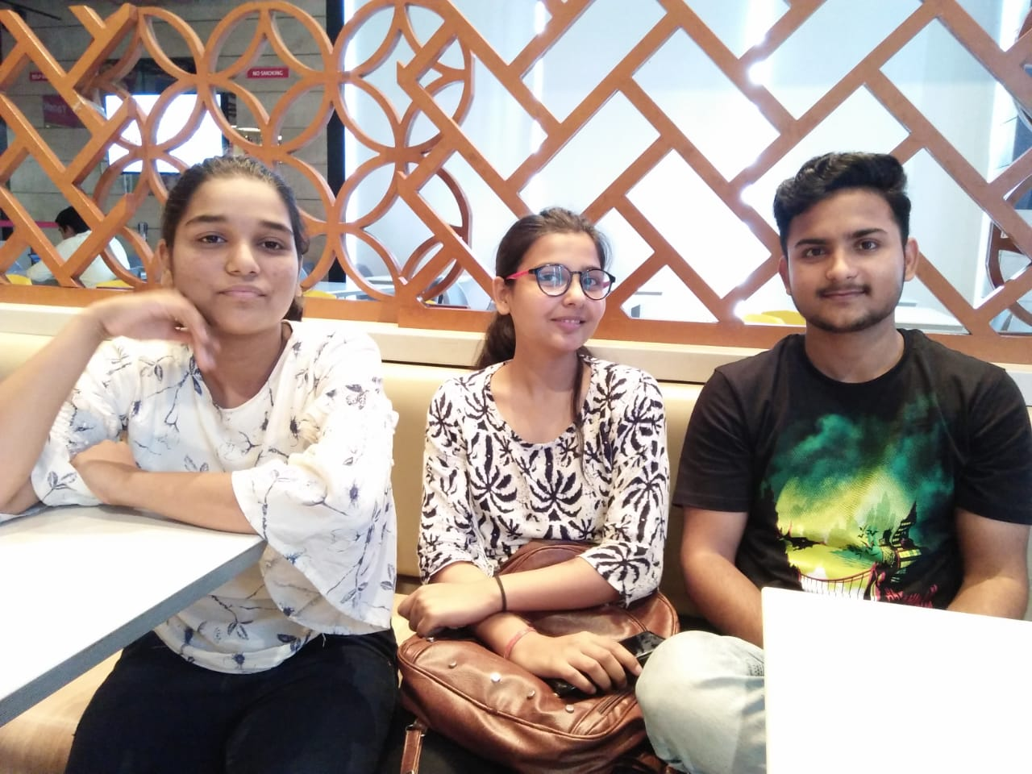
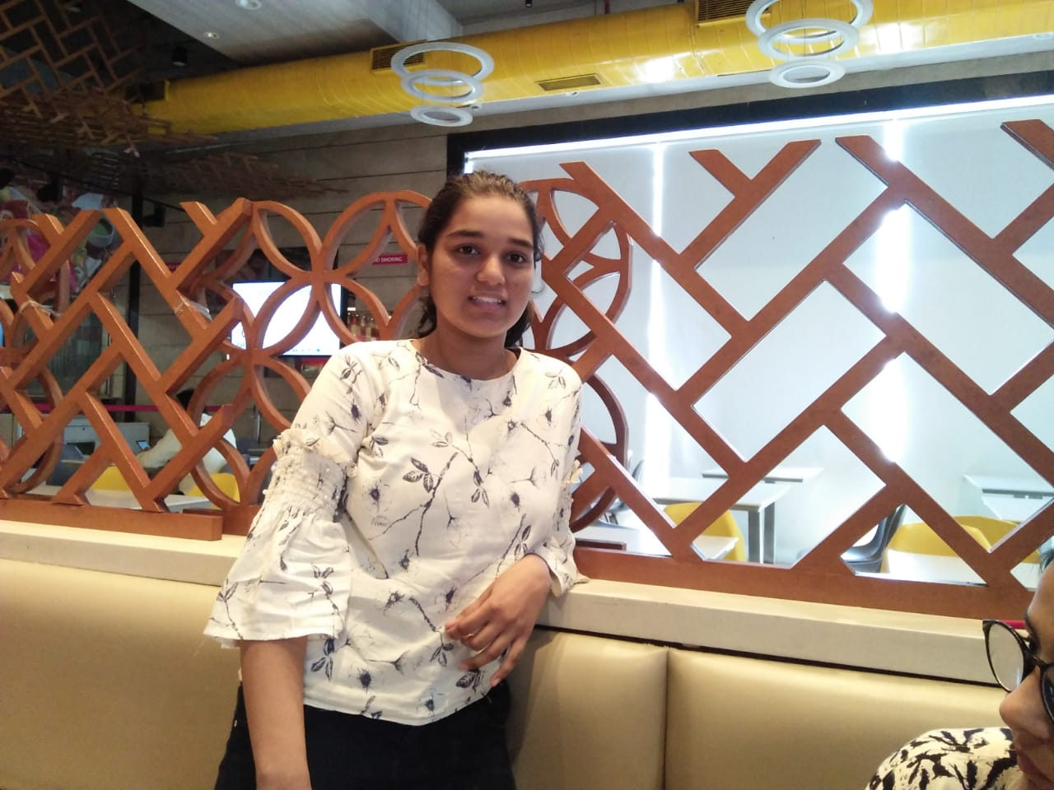
Troubleshooters
“We are here to solve your problems,
let’s get life back to normal.”
Nikhil Nagar
Developer
Nikita Rathore
Developer
Nipunika Upadhyay
Designer
Kratika Jain
Designer

Slide 4


Troubleshooters
Problems
Are you confused ?
How to do it ?
who will do it ?
Need Help ?
No one is listening ?
Want a creative solution ?
Nuclear family and No contacts …?

Slide 5


Troubleshooters
BUSINESS PLAN
What do you do , when nothing is under control. When you don’t know anything about your objective .
Issues from “Put thread into needle” to “Aerospace Engineering”, we are here to help you out from your troubles .
A webservice that solves problems that individuals face in their daily lives.
Some issues require external guidance and not possible to overcome on your own.
Troubleshooters firm will consist of both experienced and part-time employees, that have knowledge in various fields, who are ready to tackle your problem.
Customers will be provided paid diagnosis, skilled workers and suitable solution for their problems.

Slide 6

Troubleshooters
POINTS:
20 %
CREATIVITY
AND ORIGINALITY

Slide 7




Troubleshooters
In Short
Our Creative
Business Application
Troubleshooters
Analysis of your problem.
Solution of your problem .
Home delivery of skilled workers.

Slide 8

Troubleshooters
Creative Features
Support for Devanagari domain names.
Process Automation(automatic mails)
Salesforce Platform
Mobile Interface Support
Market Use
Three Categories of Troubles
Use of Static Resources
UIPath Automation for inserting records

Slide 9
Troubleshooters
POINTS:
25 %
INNOVATION

Slide 10







Troubleshooters
How it works
Thank God, TroubleShooters sent a local tow trucker at my location.
Neither me nor my friends know any tow truck driver number…
I don’t know what to do,who’ll help me .
TroubleShooters website

Slide 11



I am in trouble. Need some help for birthday party of my daughter. I want a Huge special dinosaur dummy and surprise party ,but I haven’t free time from office.
How it works
Few days later
Hemant
TroubleShooters website
Oh yes! It was amazing experience.They asked my views for party, then I was free for my work. Their assigned a professional , she did it perfectly.Party was awesome….
They found a trainee of a event management company , and charged Rs. 5000 for a planning of birthday party for my princess.

Slide 12
Troubleshooters
Revenue Strategy
Google Adsense
Sell Ad Space
Advertisements
Services
TroubleShooters
Online Customer Solution Income
Field Work (offline) Income
Commission from part time workers who got work from Troubleshooters.

Slide 13
Troubleshooters
POINTS:
10 %
ANALYTICAL
SKILLS

Slide 14


Troubleshooters
Market Strategy (only Jaipur)
Market Size : HUGE
Population : 3.8 M
There are 5 lakh families in jaipur , who will use our services. If even 3-4% of them use our service once in a year , so approx 30,000 user accounts will be generated for TroubleShooters from jaipur.
If every user, use our service once in a year….(Average Rs.1000 per service)
Total no of services used = 15,000 in first 2 years
Revenue in first two years = Rs.20 M
Revenue in three years = 20,000*1000 = Rs. 30M in 3 years
And if 5000 skilled workers connect with us as part time employee , Then they will also generate revenue for TroubleShooters.

Slide 15


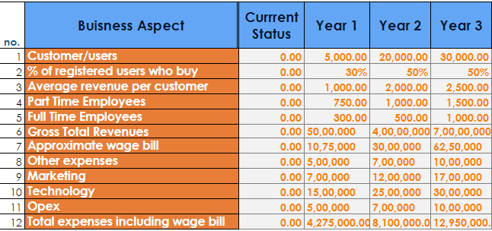
Financial Analysis
Troubleshooters

Slide 16
Troubleshooters
POINTS:
15 %
STRATEGIC
THINKING

Slide 17






Troubleshooters
Target Audience
Householders
Small industries
Skilled workers
Students
Nuclear Families

Slide 18

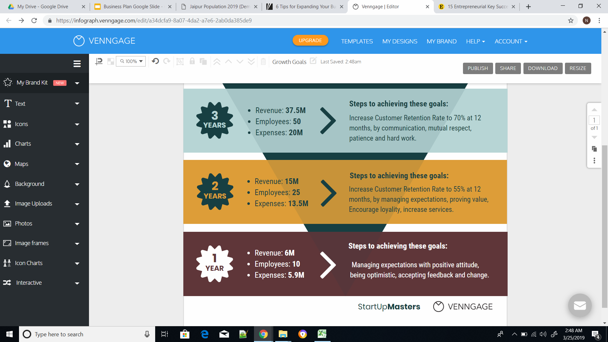

Troubleshooters
Expansion Plan

Slide 19







Troubleshooters
Growth Equation
India is a young country with a lot of untapped potential
Application development
Services in Jaipur
Profits
Other Cities

Slide 20









PARTNERSHIPS
Troubleshooters

Slide 21
Troubleshooters
POINTS:
30 %
PRACTICAL
IMPLEMENTATION

Slide 22

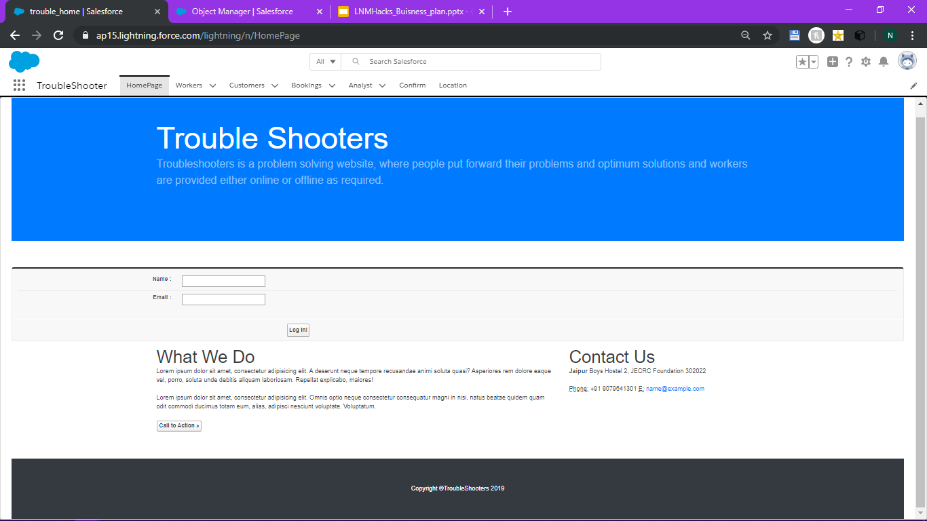

Slide 23
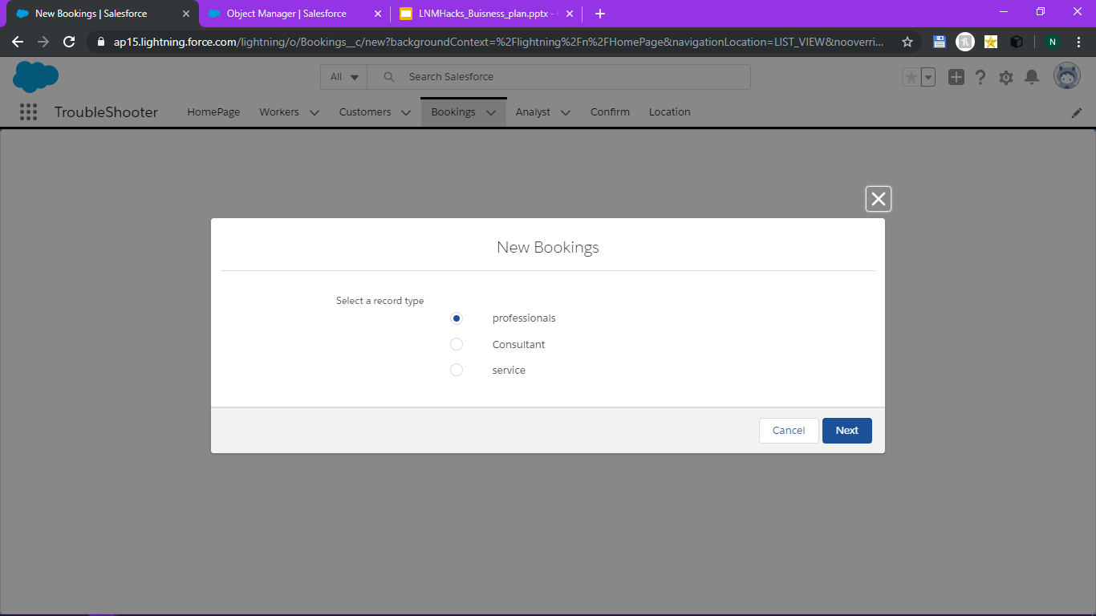

Slide 24
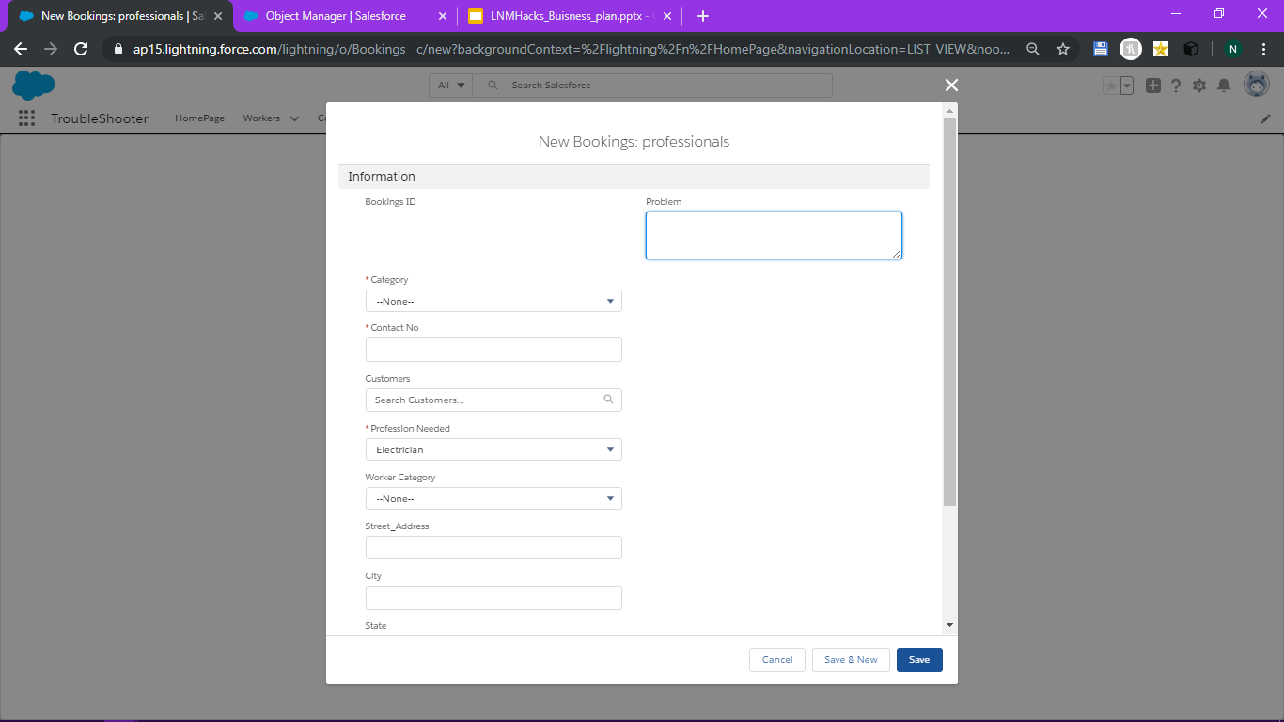

Slide 25
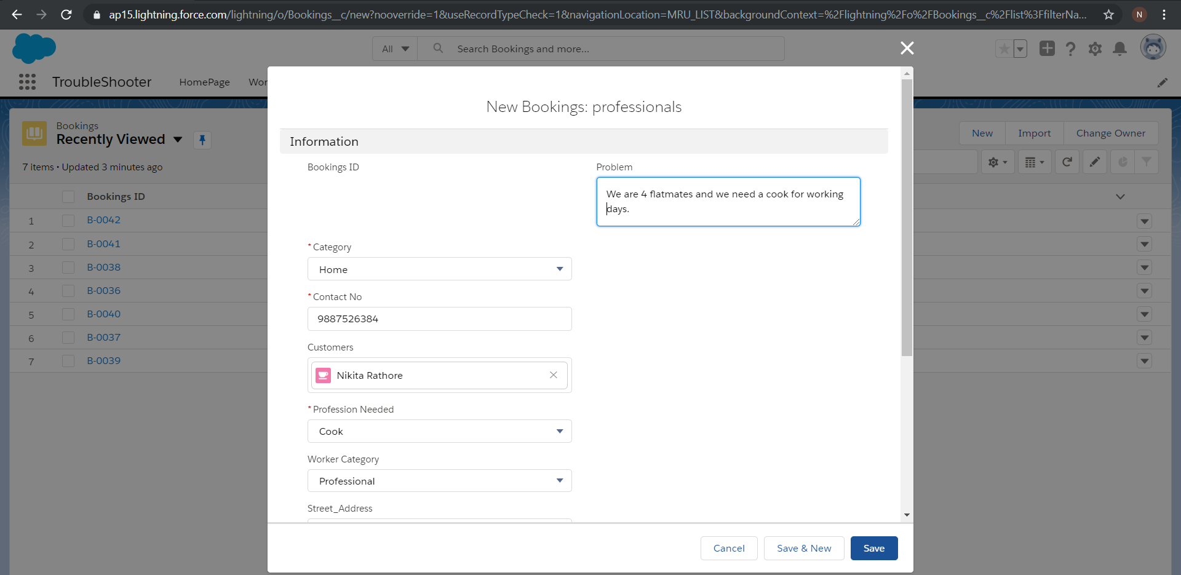

Slide 26
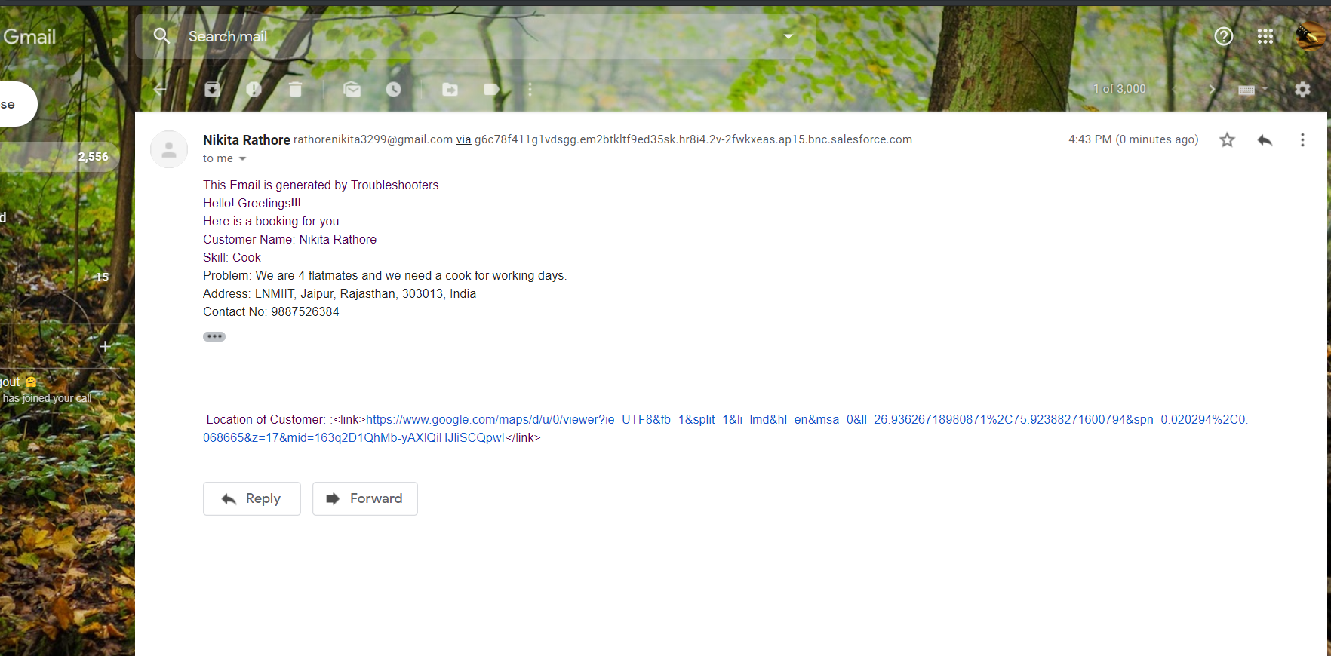
Automatic Email sent to specific worker , who has same profession , as customer wanted.

Slide 27
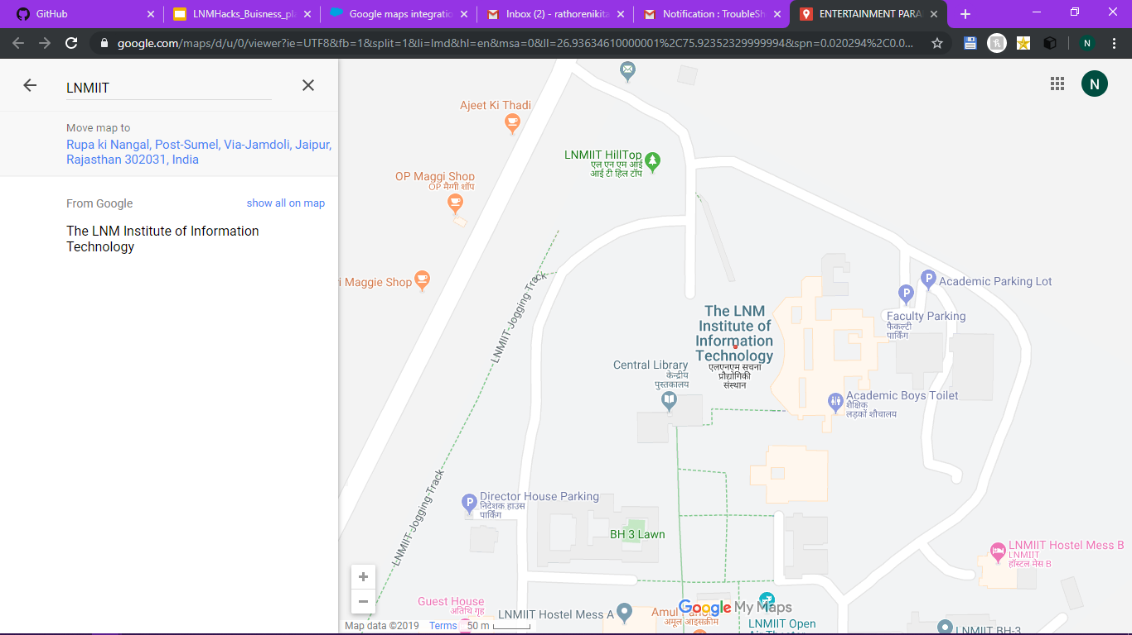
The location link on mail , redirects the worker to customer’s location map view.

Slide 28

www.troubleshooters.com

Slide 29
THE END
Thank You

